Slide 1
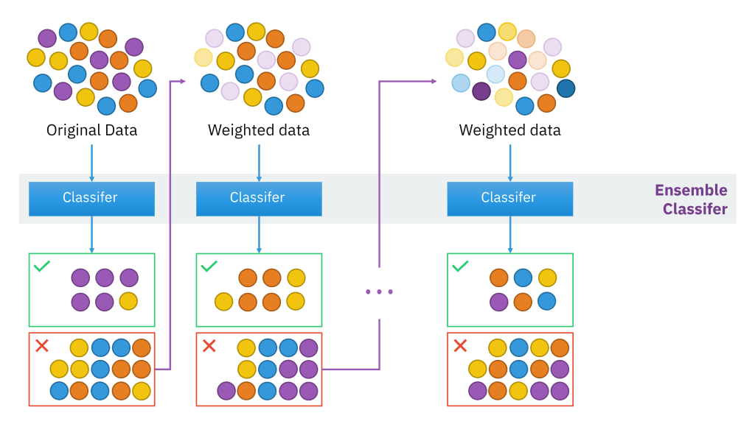
AdaBoost
AdaBoost (Adaptive Boosting) is a very popular boosting technique that aims at combining multiple weak classifiers to build one strong classifier.

Slide 2
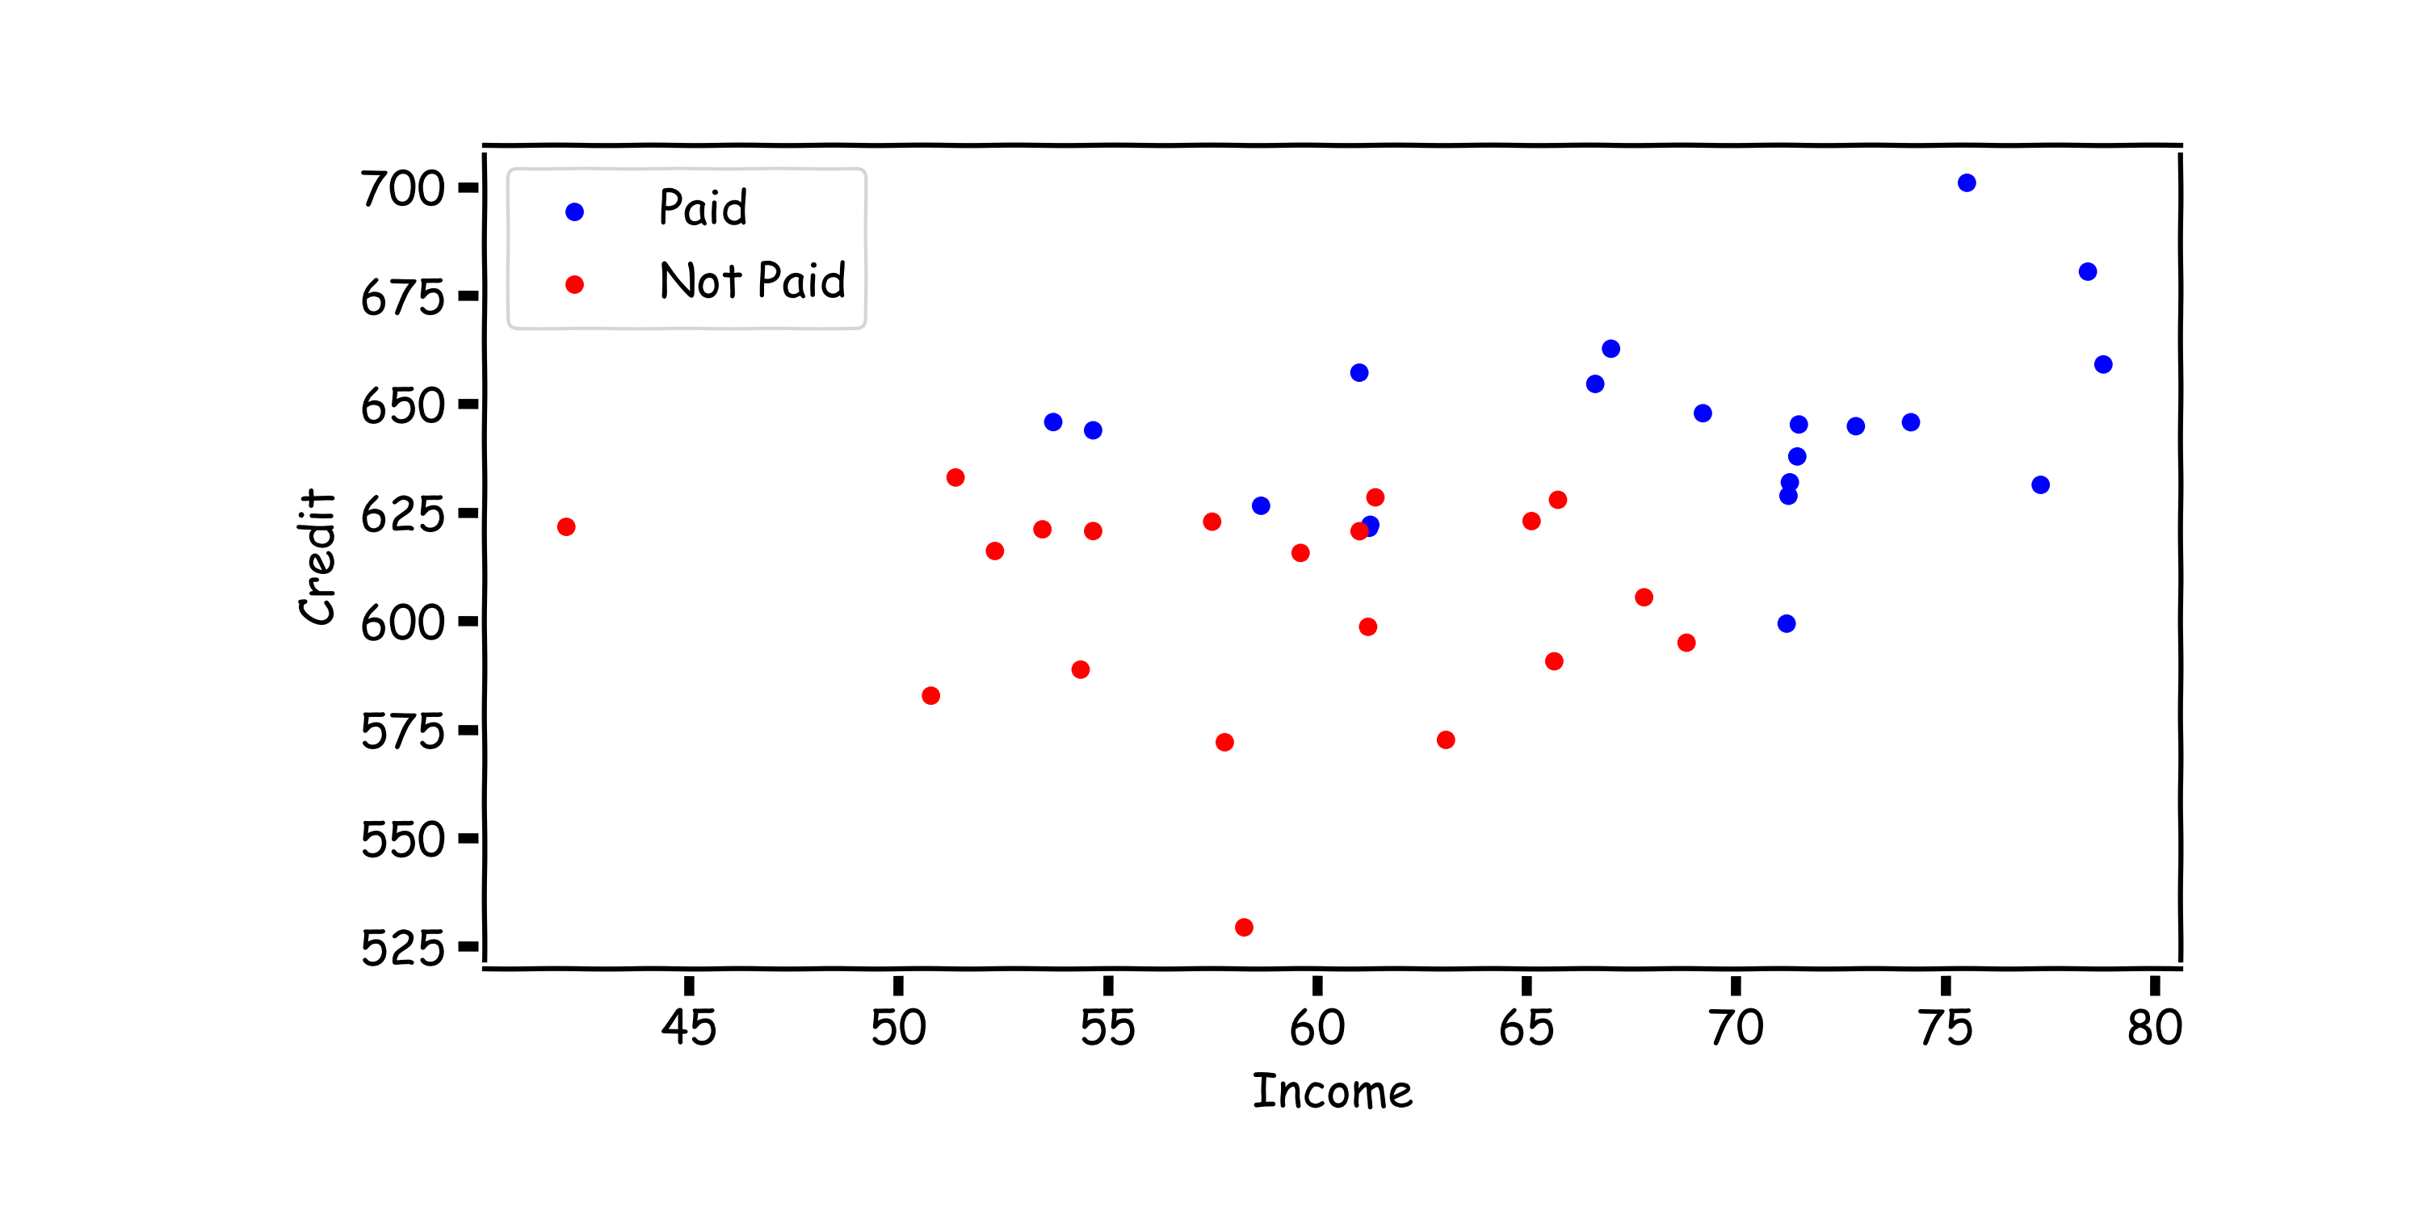
AdaBoost: start with equal weights

Slide 3
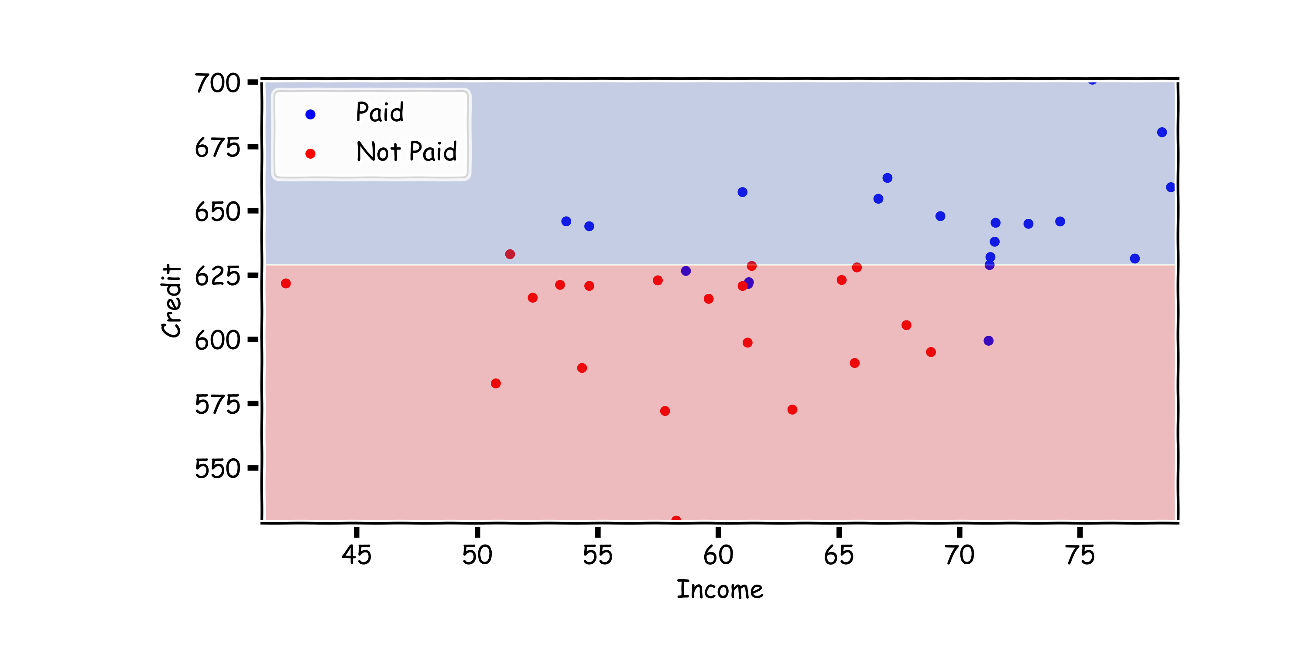
AdaBoost: fit a simple decision tree
fit a simple classifier T^{(i)}

Slide 4
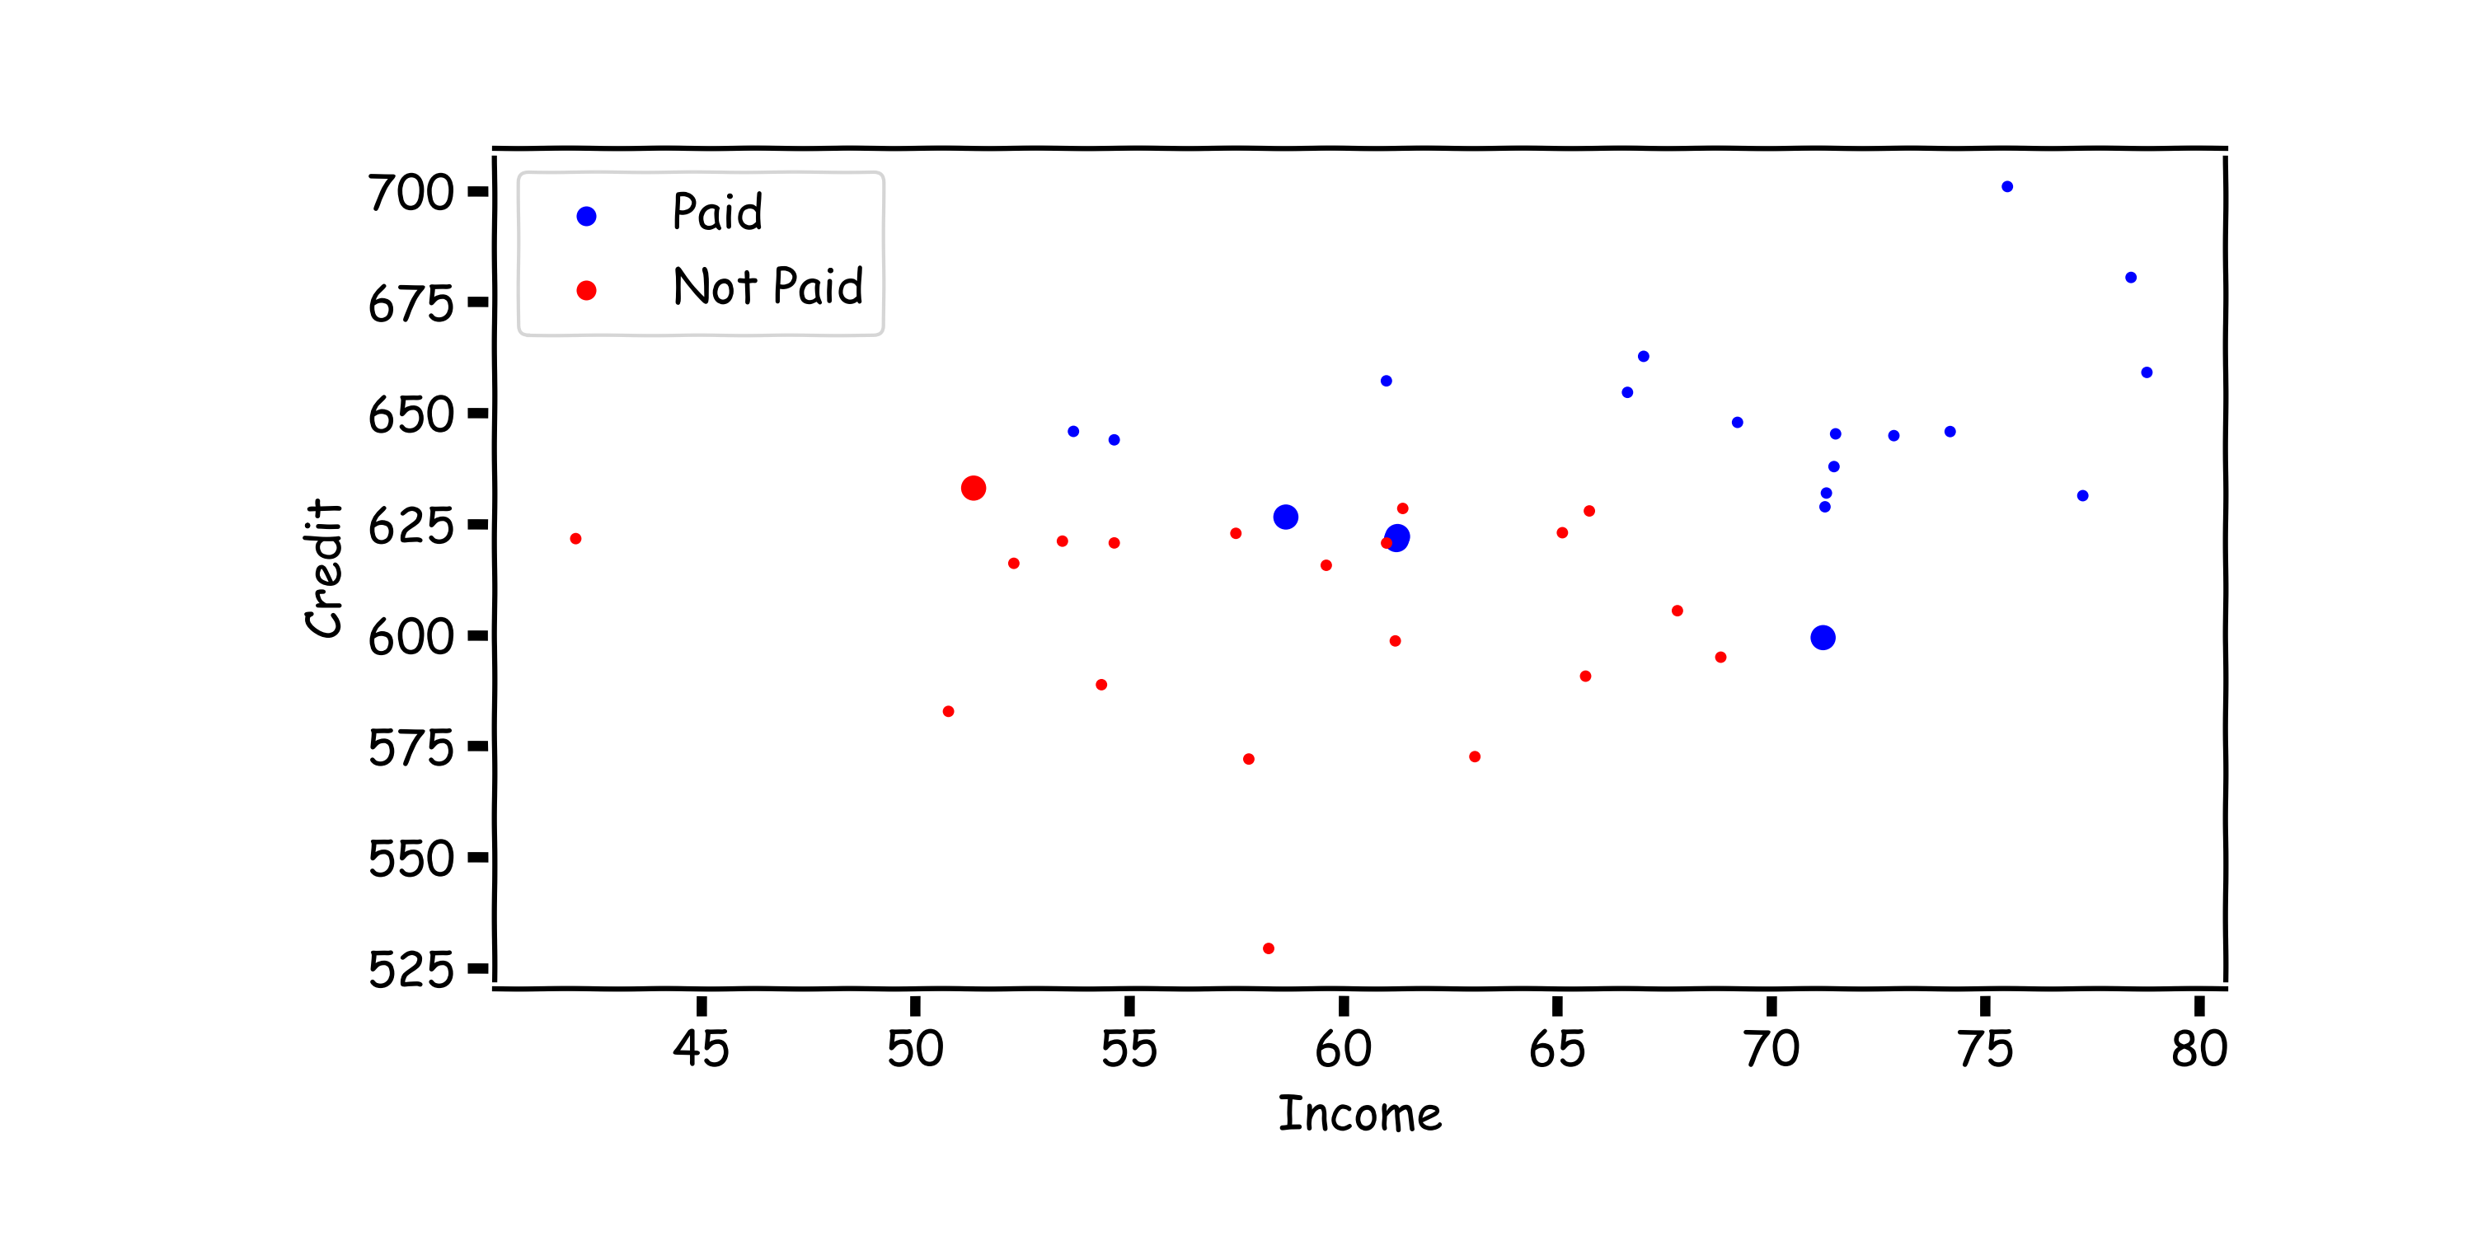
AdaBoost: update the weights
Update the weights:

Slide 5
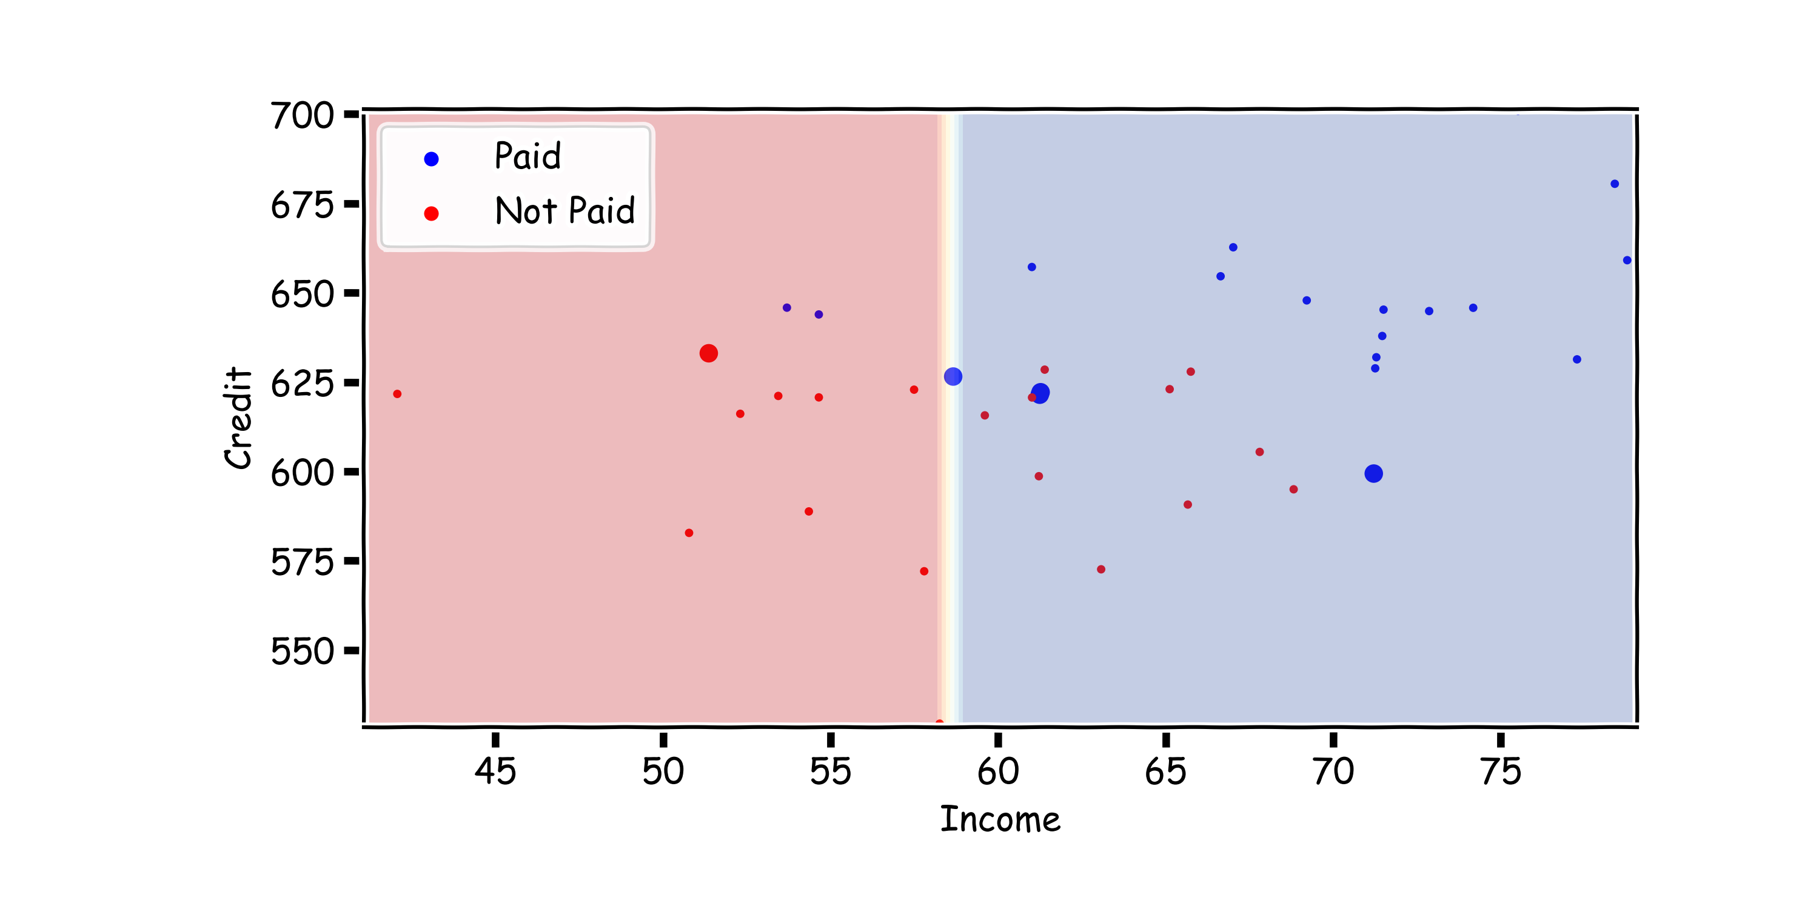
AdaBoost:
fit another simple decision tree on re-weighted data

Slide 6
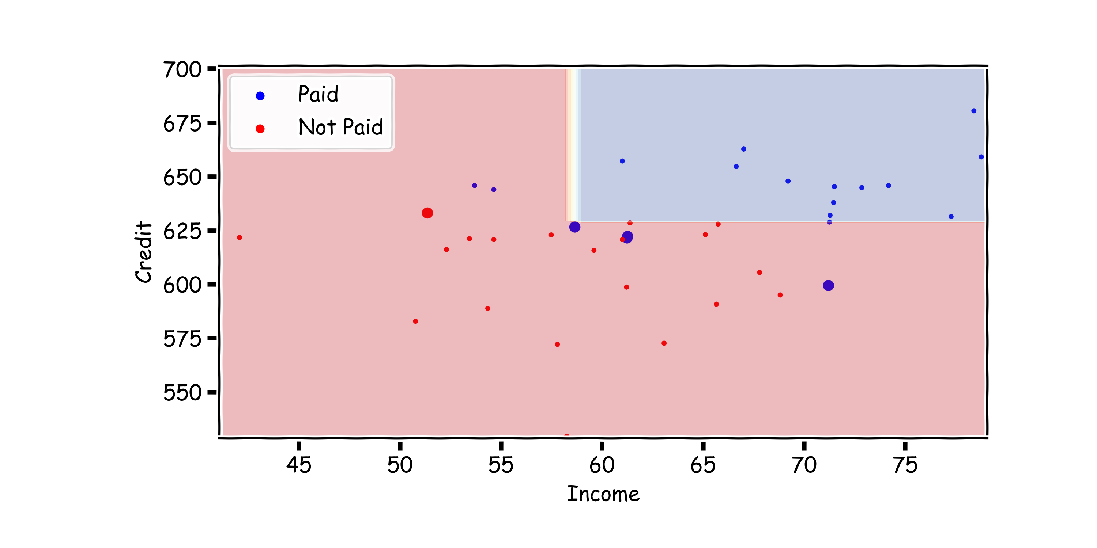
AdaBoost:
$$\text{add} \text{the} \text{new} \text{model} \text{to} \text{the} \text{ensemble}\text{: }T←T+λ^{(i)}T^{(i)}$$

Slide 7
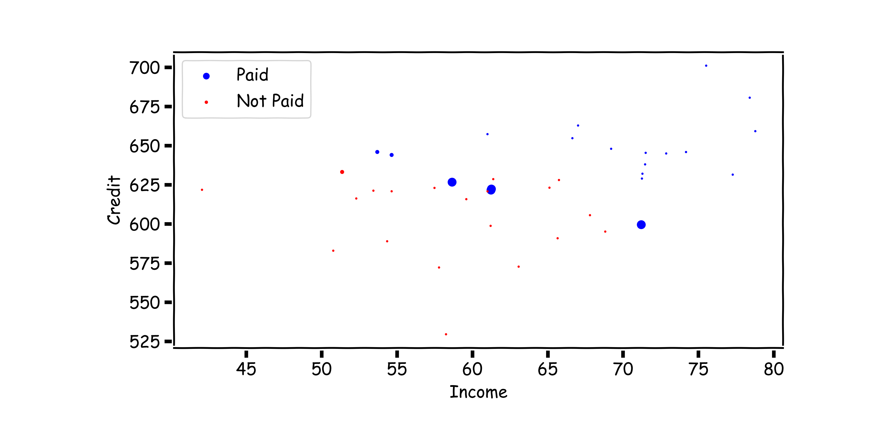
AdaBoost: update the weights
Update the weights:

Slide 8
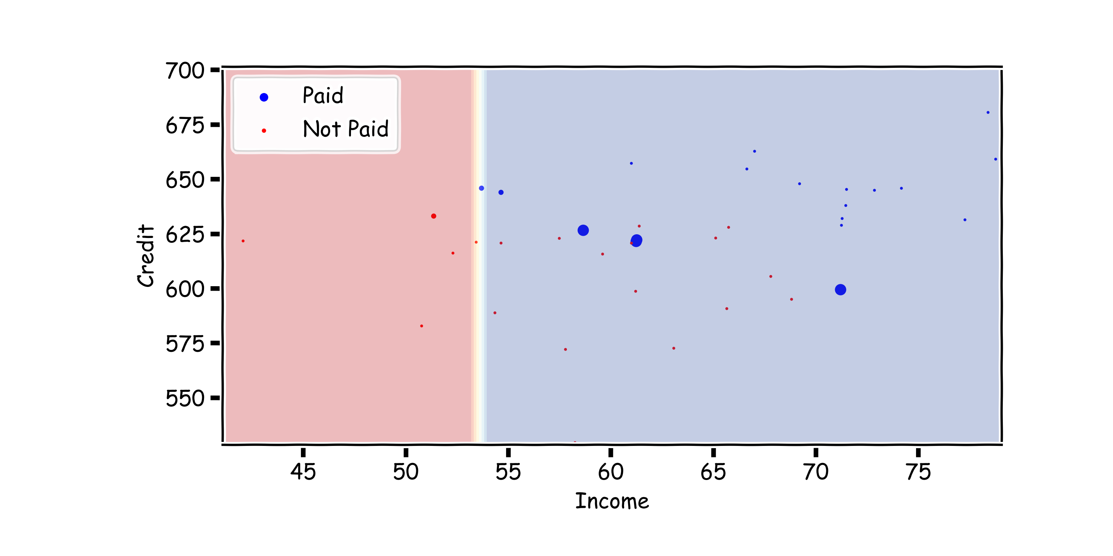
AdaBoost
fit another simple decision tree on re-weighted data

Slide 9
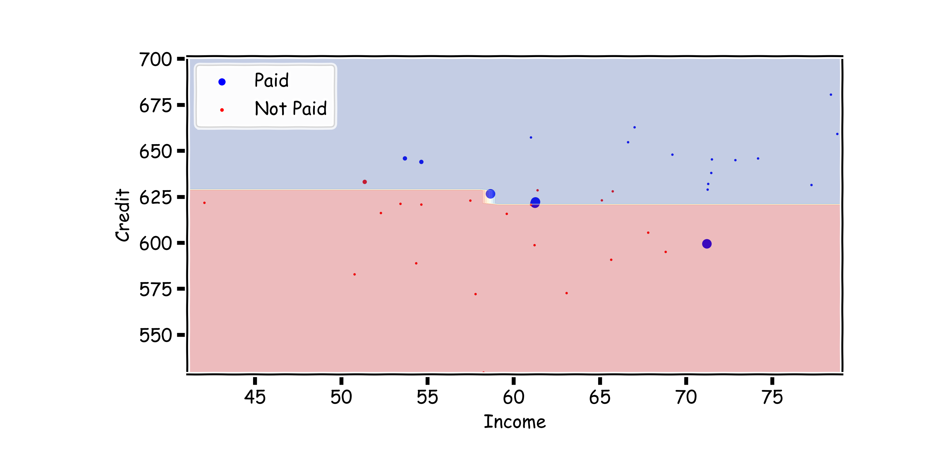
AdaBoost: add the new model to the ensemble, repeat…
$$\text{add} \text{the} \text{new} \text{model} \text{to} \text{the} \text{ensemble}\text{: }T←T+λ^{(i)}T^{(i)}$$

